Slide 2

Class Bucks
https://ibelong.byui.edu/home_login
One Class Buck for each activity:
Please have your count ready when I come by.
School Resource:
Arts, Sports/Fitness, Health Srv, Points of Interest
Academic Resources:
Tutoring: Lab or Library: Tuesday, Thursday, Friday 3:30-6:30, STC375/385/394/384, CSE Volunteer Tutor Lab
Department Services
Computing Society: 5:00-5:30, STC375/385/394/384,
Forum: Thurs: 11:30
Experience:
Career Center
Work (every 4 hrs)
Networking & Informational Interviews
Personal Growth
Disciples of Christ: Church, Devo, FHE
Dating, Workshops, Books,

Slide 3
CSE 300
Module 04

Slide 4
Announcements

Slide 5
Week 02: Module 3 (Friday -Mon)
Elevator Pitch 3.0 1.0: Intro-> 2.0: 5 Sent. -> 3.0: VMOCK
Interviewing 1.0 About job interviewing
Employer List 2.0 1.0: Wish: -> 2.0: List of 100 companies
Ntwk Contact 2.0 1.0: F&F: -> 2.0 List of 100 people
Info. Interview 1.0 About Informational Interviews
Resume 3.0 (V) 1.0: Login-> 2.0 Dept 10pts->3.0 VMOCK
Reference 2.0 1.0: Init -> 2.0 Letter of Recommendations

Slide 6
Week 03: Module 04 (Tues-Thur):
Portfolium 2.0 1.0: Login-> 2.0: Profile Strength
Elevator Pitch 4.0 30-second video -> BYU-Connect from VMOCK
Employer List 3.1 1/5 Dossier
Ntwk Contact 3.1 5 Profiles
Handshake 2.0 1.0: Login -> 2.0: Optimization
LinkedIn 2.0 1.0: Login -> 2.0: Optimization
BYUI Connect 2.0 1.0: Login -> 2.0: Optimization
Resume 4.0 1.0: Init->2.0: 10 pts->3.0VMOCK -> 4.0 Professional Review
Info Itnrvw Prep 2.1 1.0: Info-> 2.0 Ask for interview

Slide 7
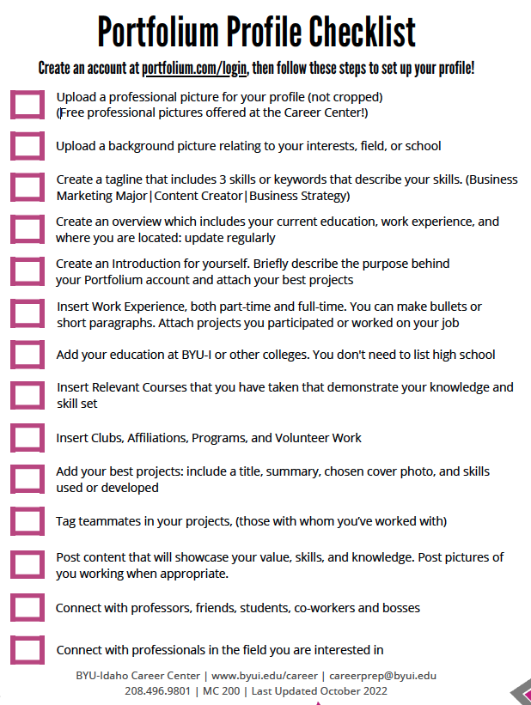
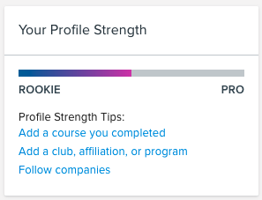
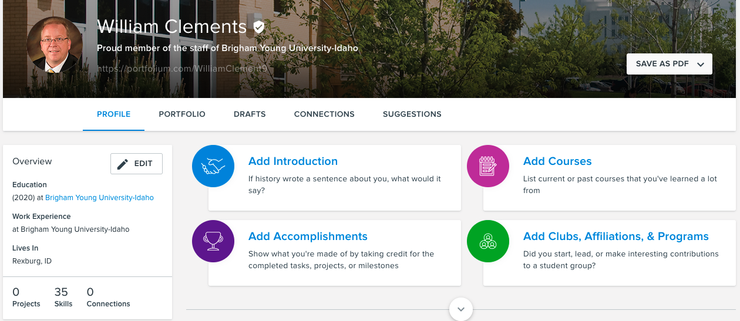
Portfolium 2.0
https://portfolium.com
Profile Picture and Cover Image
Personal Introduction
Elevator 2.0 – 5 sentences
Education Section
Graduation Plans – Resume 2.0
Work Experience
Resume 2.0
Profile Strength: Pro

Slide 8
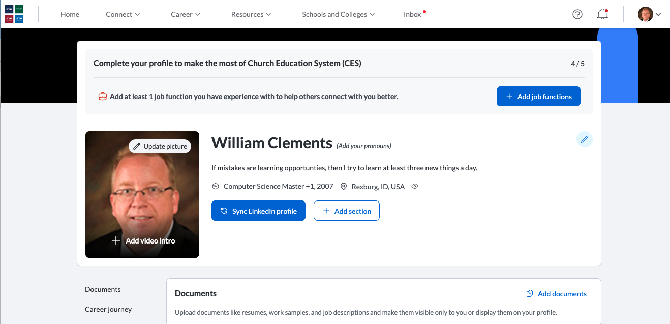
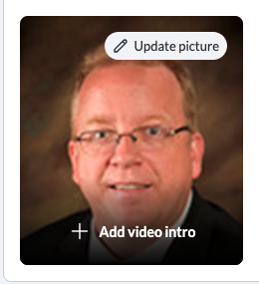
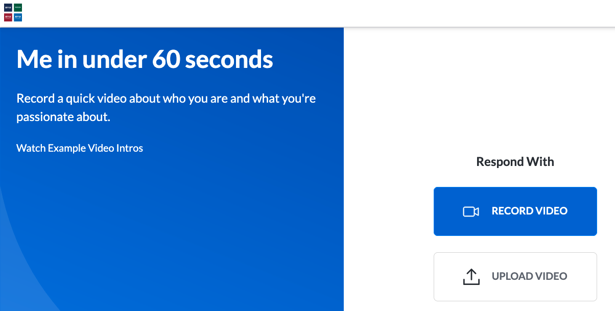
Elevator Pitch 4.0
Elevator Pitch 1.0: Introduction
Elevator Pitch 2.0: 5 sentences
Elevator Pitch 3.0: VMOCK
Elevator Pitch 4.0: BYUIConnect
BYUIConnect 1.0

Slide 9
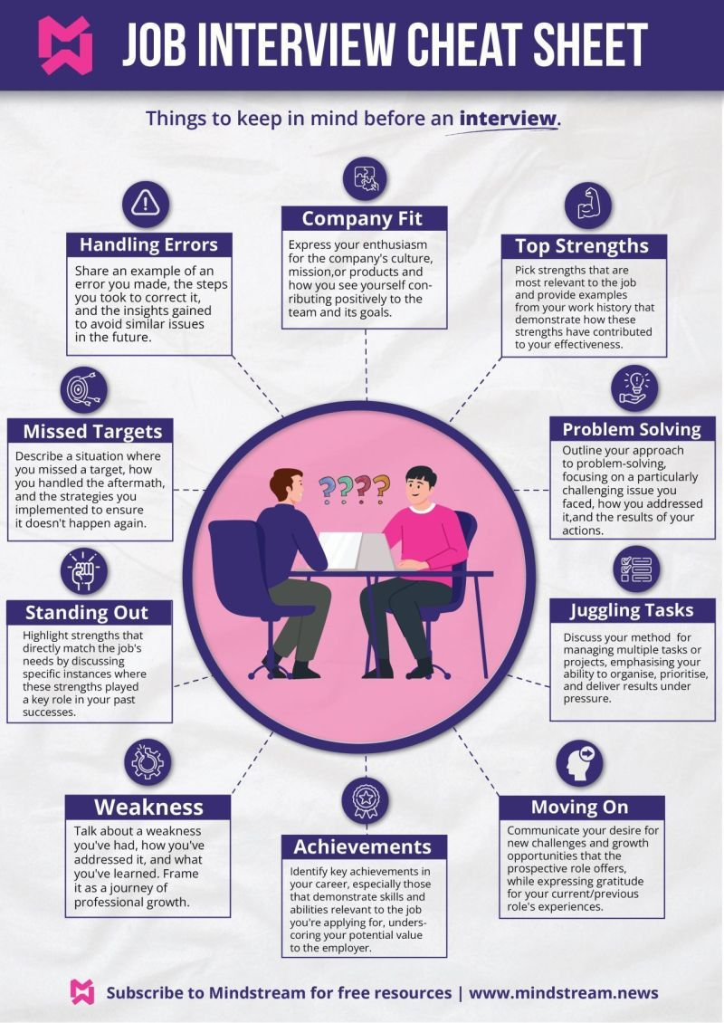
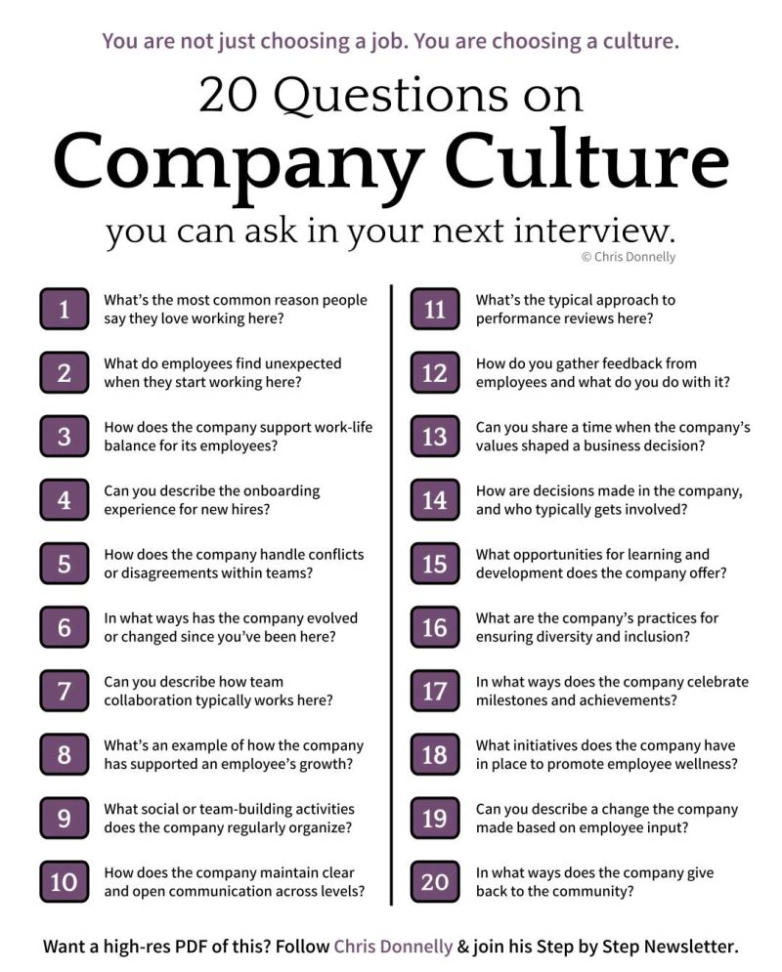

Slide 10
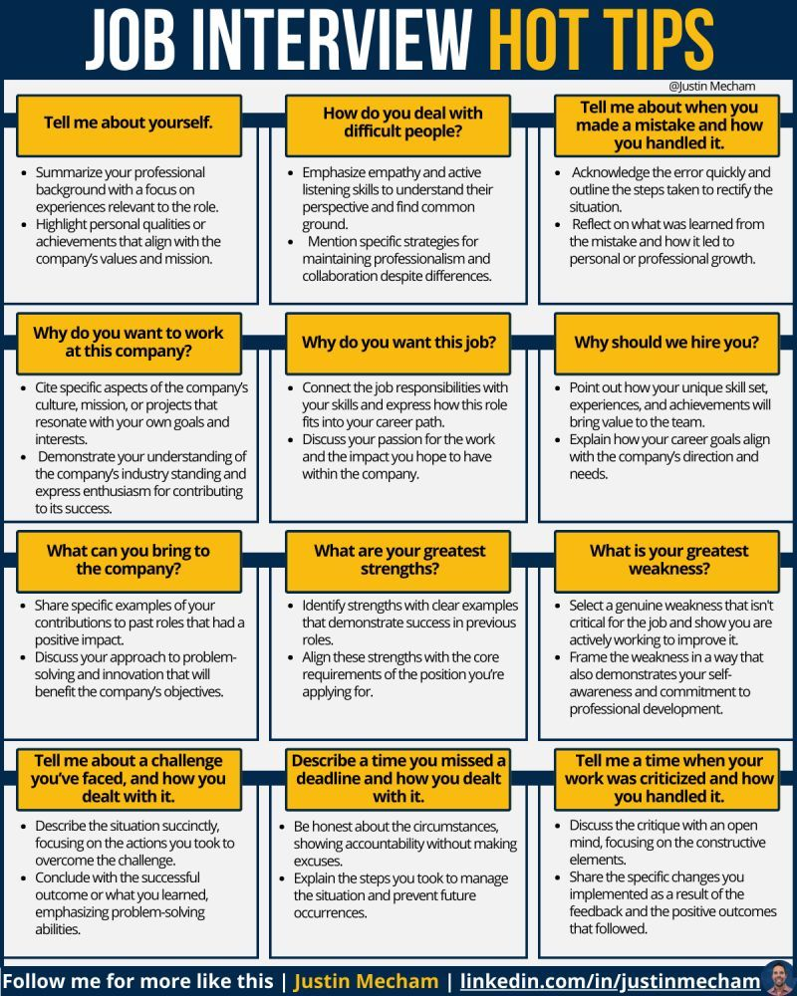
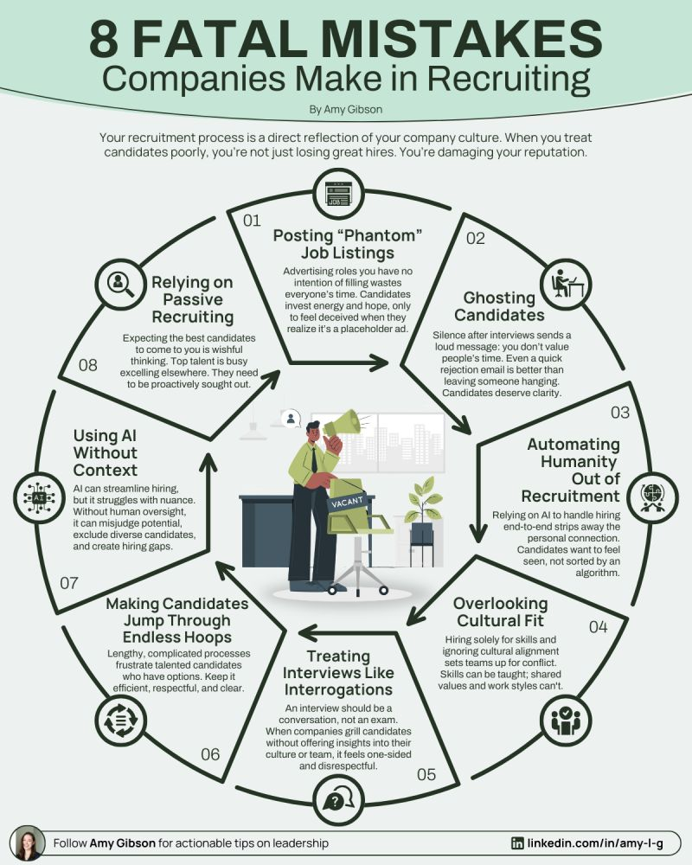

Slide 11
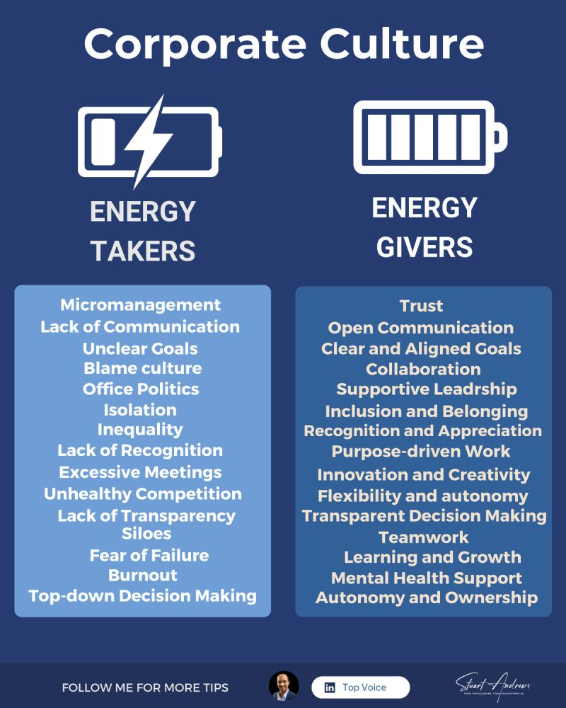
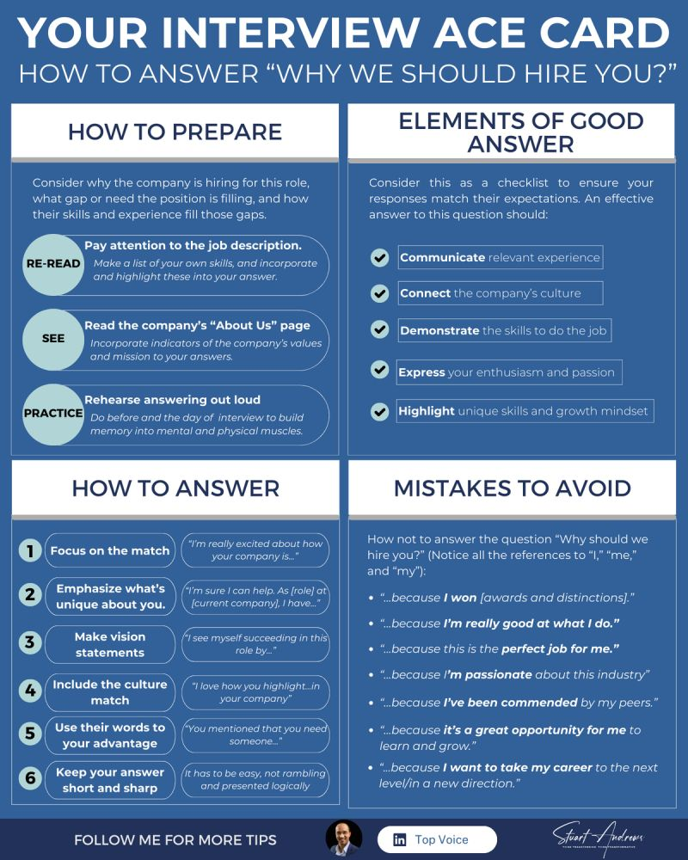

Slide 12

The woman who built Zuckerberg's leadership team
Her secret? Spotting future leaders with ONE interview question.
But her real superpower wasn't spreadsheets or strategy
It was spotting future legends with ONE deceptively simple question: "If you were in my role, what would you focus on?"
The best answers shared 3 traits: • Deep understanding of real challenges (not fluff) • Scalable solutions (not band-aids) • Clear mission alignment (not chasing metrics)
The question wasn't just about hiring - it revealed how candidates would approach leadership. • Would they own problems or play the blame game? • Could they turn big ideas into real action? • Did they think in systems or quick fixes?
Notes:
https://www.linkedin.com/posts/justinas-pasys_facebook-technology-humanresources-activity-7286676055426281472-BruG?utm_source=share&utm_medium=member_desktop

Slide 13

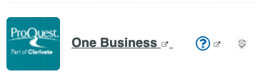
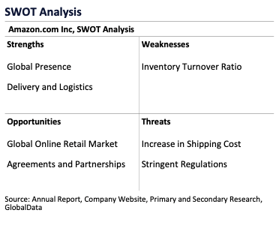
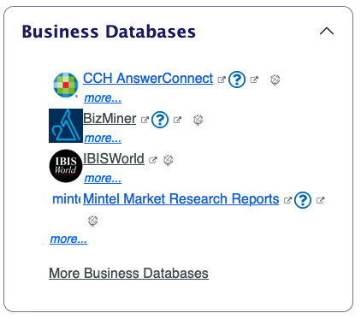
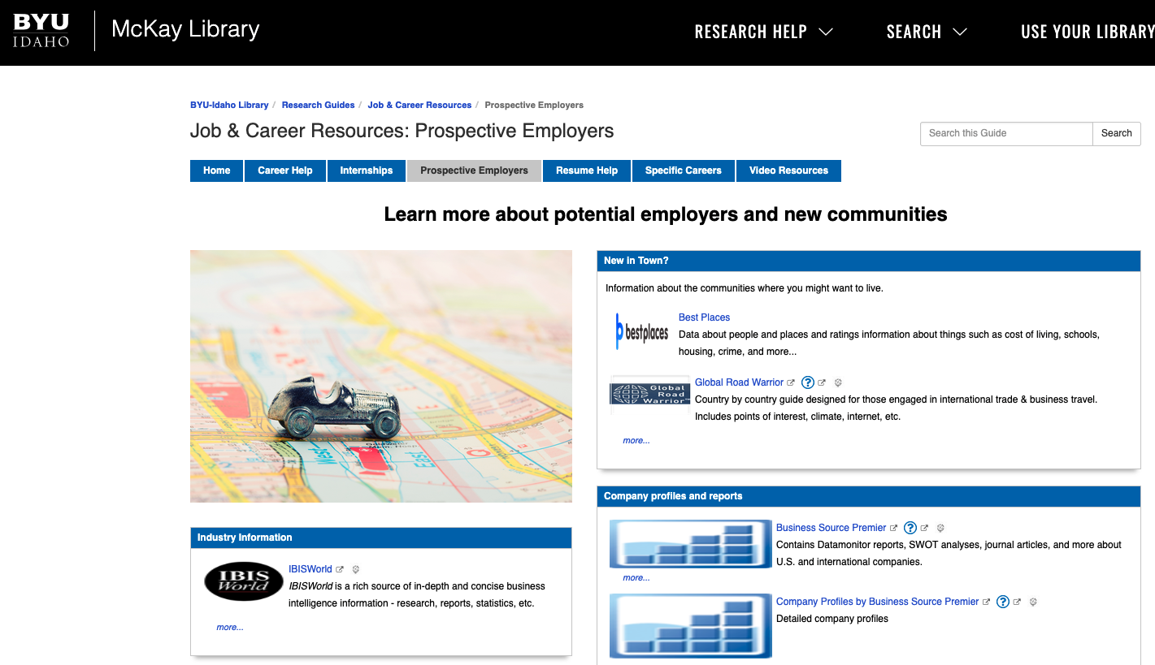
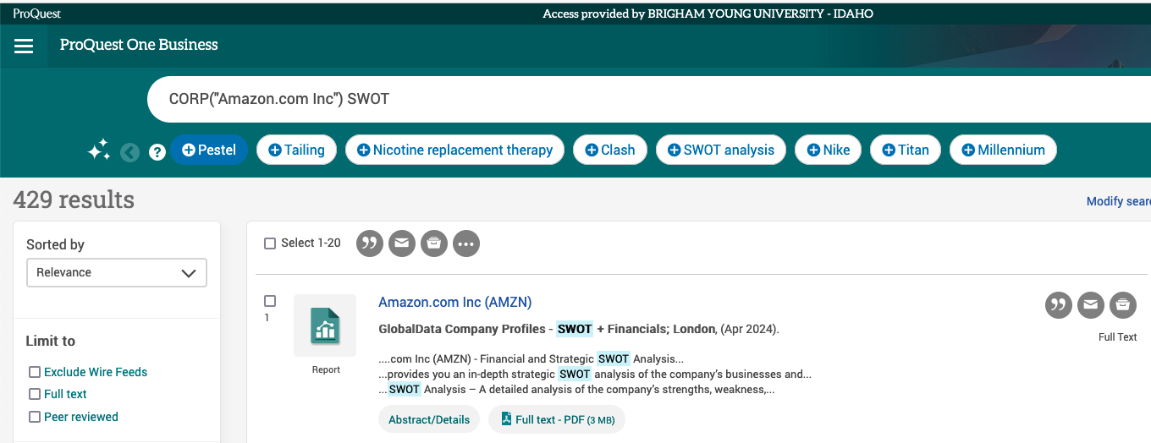
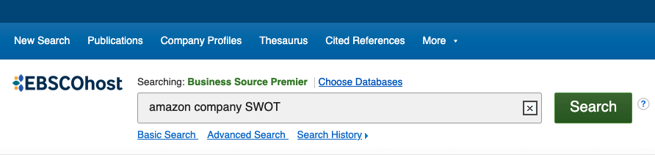
Employer List 3.1 1/5 Dossier
Company Name:
Company Trading Exchange:
Mission, Vision, and Values:
Company Overview:
Company Strengths, Weaknesses, Opportunities, and Threats (SWOT):
Financials:
Business Segments:
Industry:
Jobs (Company Job Board):
Recent Events
Access via McKay Library’s A-Z Databases.
Industry Insights: BizMiner.
Use BizMiner’s Company Profiles for personnel connections.
Explore Industry Market Profiles for market area insights and competitor lists
Example: Amazon? WA?
ProQuest One Business.
Search for company overviews, SWOT, competitors, and recent activities.
EBSCO: MarketLine.
Find SWOT analysis via Business Source Primer for insights into strengths, weaknesses, opportunities, and threats.
I.e.: Amazon Company Profile
Company Website.
Discover mission, products, and job opportunities.
LinkedIn:
Follow the company.
Find five interesting posts and analyze them.
Use LinkedIn’s filters to explore employees who share your major, location, and skills. Add them to your contact list.

Slide 14
Ntwk Contact 3.1
Use resources like BYUI-Connect, Handshake, LinkedIn, and other sources to gather the following details for each contact: Name
Major
Company Roles and Responsibilities
Other Company Job Titles
Interests
Why?
Why 5? –
Ask 5 people for an interview, odds are one will response.
Other reason, practice.

Slide 15
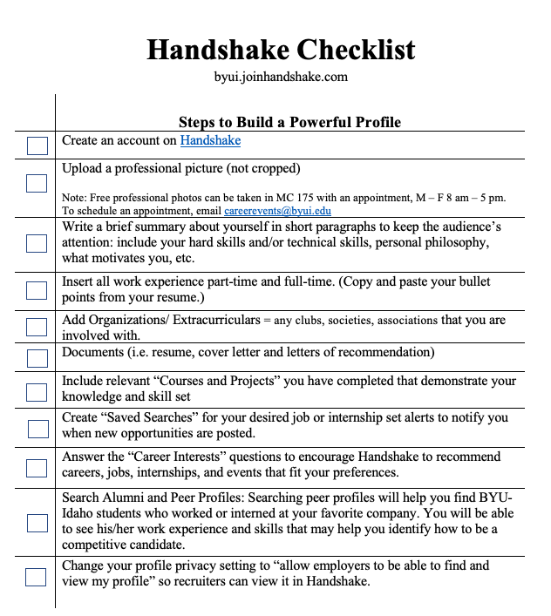
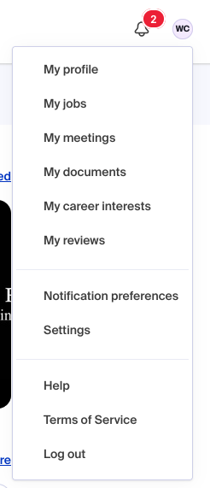
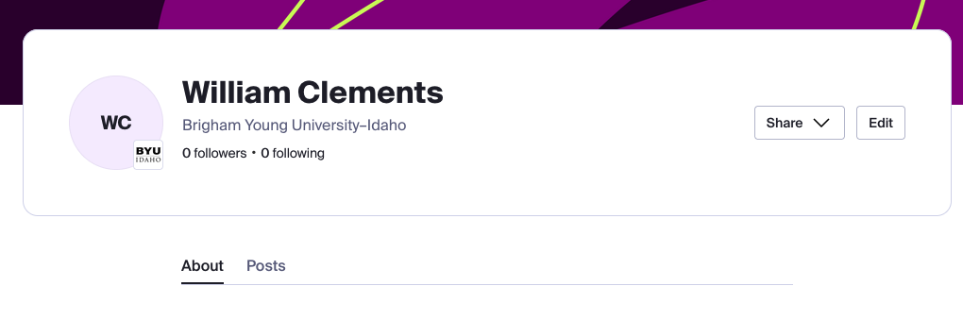
Handshake 2.0

Slide 16
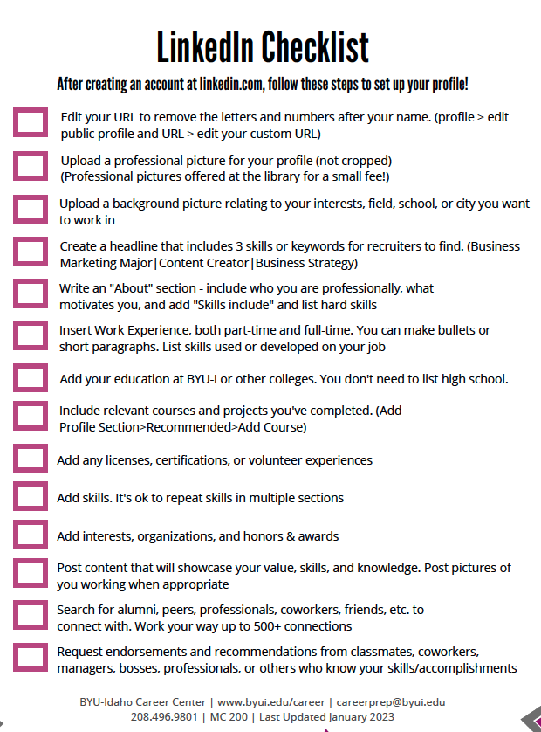
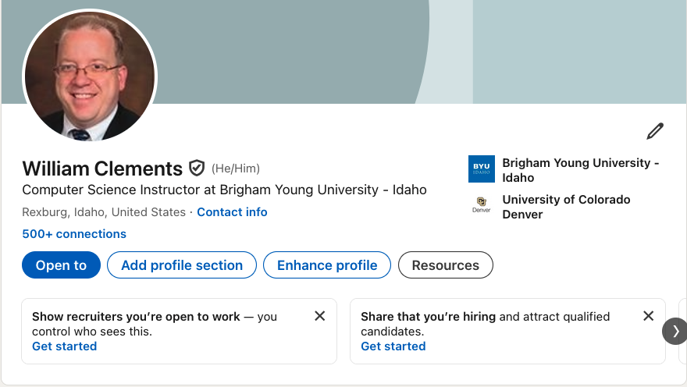
LinkedIn 2.0

Slide 17
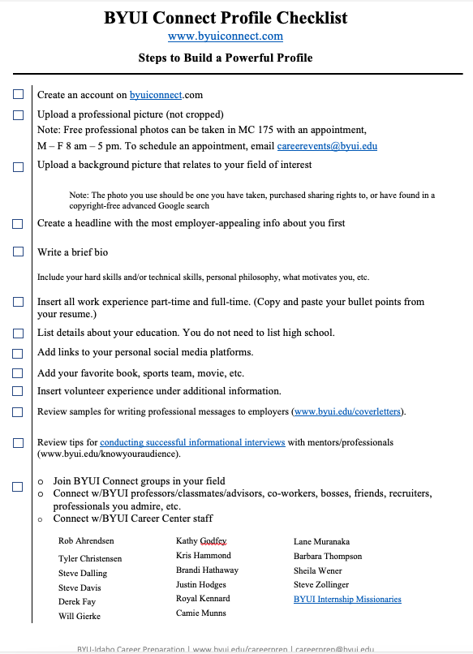
BYUI Connect 2.0

Slide 18
Resume 4.0 Professional Review
Find a Professional Contact:
Identify a professional from your Contact List 4.0 who works a full-time job, preferably in your field of study.
This person could be a relative, instructor, coach, or industry professional.
Reach out to them to confirm their availability to review your resume. You may need to contact more than one person depending on schedules.
Obtain Feedback:
Provide the professional with a printed copy or email version of your resume.
Request their feedback on the document. Encourage them to use red pen or provide detailed notes.
Take notes during the review or retain the marked-up version as evidence of the review.
Revise Your Resume:
Incorporate the feedback received into a revised version of your resume.
Send a Thank You Note:
Write and send a thank you letter to the professional who reviewed your resume, expressing appreciation for their time and insights.
This is practice for Informational Interview question:
Based on what we discussed, what recommendations would you suggest I work on for my Resume.

Slide 19
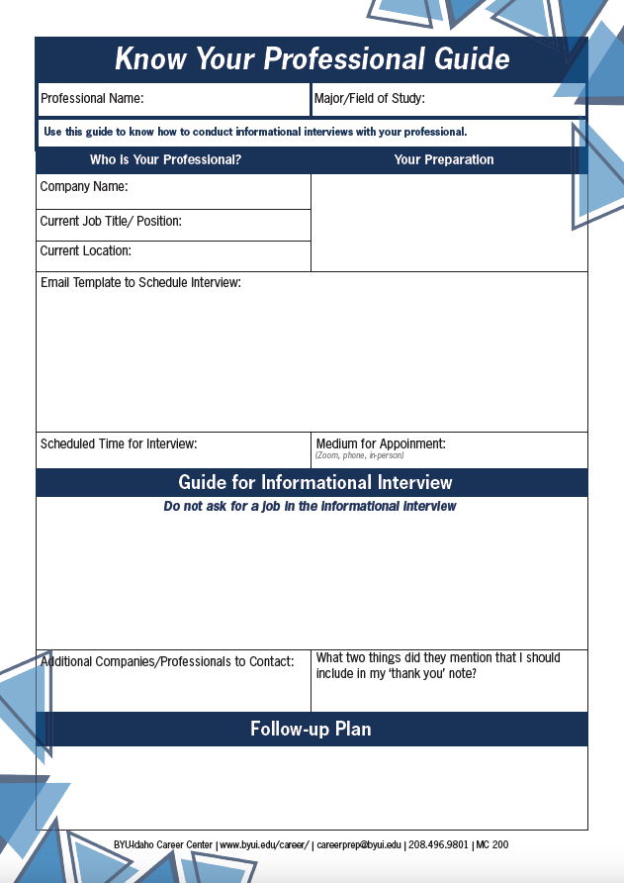
Info Itnrvw Prep 2.1 Ask for interview
Basic Information:
Professional Name:
Major/Field of Study:
Who is Your Professional?
Research their background and summarize their current role.
Fill in the following details:
Company Name:
Current Job Title/Position:
Current Location:
Additional Contact Information: Email and Phone Number:
Your Preparation:
Schedule Time for Interview

Slide 20
Info Itnrvw Prep 2.1 Ask for interview
Positive Questions: You want to know something about the company, project and job that you can’t find out from online resources.
1st Q: What they like about their job?
2nd Q: Any additional follow-on questions you prepared.
Review Resume “Based on what you have told me so far, could you take a look at my resume, and provide any suggestions that would help me out professionally?”
Additional Companies/Professionals to Contact: As part of networking you need to expand your opportunities to talk to other professionals. Ask to grow your network, by asking your network for contacts.
Ask: Who else should I talk to or interview
What two things did they mention that I should include in my ‘thank you’ note? Look over your notes and determine two follows up actions that you will take. If you can’t, remind your contact that you will follow up with an updated resume and if there is another assignment that you should work on. So put at least two bullets space for
Resume: ____, and
Action Item: ___

Slide 21
Info Itnrvw Prep 2.1 Ask for interview
If you fail to plan, you …
Follow-up Plan Start off with the following checklists, and as you learn more as you conduct the interview.
[ ] Thank you note
[ ] Resume update
[ ] Lessons learned
[..] Additional Insights

Slide 22
Week 03: Module 05 (Fri-Mon): Upcoming
Confidence 5.0
BYUI Connect 3.0: 1.0: Login-> 2.0: Opt-> 3.0: Building Mentorship and Group Engagement.
Elevator Pitch 5.0: Pitch 59
Connectivity 5.0
Employer List 3.2 2nd of Five Dossiers.
Network Contact List 3.2 Profiles.
Professionalism 5.0
Informational Interview 3.1 Scheduled Interview
Info Interviews Prep 2.2 Prepare Form

Slide 23



Chapter 2 of your User Manual Building your Odyssey
Based on Stanford’s Designing Thinking Course and Book: “Designing your Life”
Topics in this Chapter
Where are you?: Health, Work, Play, and Love Dashboard
Building a Compass: Workview and Lifeview
Using the compass: Keep a Good Time Journal
Idealizing: Mind Map
Create your Journey Odyssey Plan
1
2
3
4
5

Slide 24


What is holding you back?
Designers Like problems
Designers Like questions
Designers are Doers
Think like a designer
Be Curious, Try Stuff, Reframe Problems, Know it’s a process, Ask for Help
Problem Finding + Problem Solving = Well Designed Life
Gravity Problems (QuickSand)
Don’t worry about Problems that you don’t have solutions
Circle of influence
Designing to get unstuck
Start where you are. Not in the past or future

Slide 25



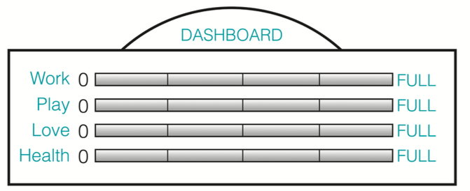
Where are you? Health, Work, Play, and Love Dashboard
Action
Define: Write a few sentences about how it’s going in each of the four areas
Measure: Mark where you are (0 or full) on each gauge
Scale: 0, ¼, ½, ¾, full
Analysis: Ask yourself if there’s a design problem you’d like to tackle in any of these areas.
Summary: Now ask yourself if the ”problem” is a gravity problem
Health
Healthy to us means being well in more than just your body; you might want to take into account mind and spirit, too.
Work
All the ways you work, paid to do, 1st and 2nd job, volunteer, home and family
Play
Bring joy. Include organized activities, and productive endeavors, for fun, not merit
Love
Where love flows in your life. Primary relationship: where we go first for love
Then it’s a flood of people, pets, communities, or objects of affection.
2 minutes each – 8-10 minutes

